Slide 2
Digital Circuits Design Fundamentals
Chapter 3
Combinatorial Logic Design
Part 1 – Implementation Technology and Logic Design
Fei Wang, 2024
Chapter 2 - Part 1 <number>

Slide 3
Overview
Part 1 - Implementation Technology and Logic Design
  Design Concepts and Automation
    Fundamental concepts of design and computer-aided design techniques
  The Design Space
    Technology parameters for gates, positive and negative logic and design tradeoffs
  Design Procedure
    The major design steps: specification, formulation, optimization, technology mapping, and verification
  Technology Mapping
    From AND, OR, and NOT to other gate types
  Verification
    Does the designed circuit meet the specifications?
Part 2 - Programmable Implementation Technologies
  Read-Only Memories, Programmable Logic Arrays, Programmable Array Logic
    Technology mapping to programmable logic devices
Chapter 3 - Part 1 <number>

Slide 4
Combinational Circuits
A combinational logic circuit has:
  A set of m Boolean inputs,
  A set of n Boolean outputs, and
  n switching functions, each mapping the 2^{m} input combinations to an output such that the current output depends only on the current input values
A block diagram:
Combinatorial
Logic
Circuit
m Boolean Inputs
n Boolean Outputs
Chapter 3 - Part 1 <number>

Slide 5
Hierarchical Design
To control the complexity of the function mapping inputs to outputs:
  Decompose the function into smaller pieces called blocks
  Decompose each block’s function into smaller blocks, repeating as necessary until all blocks are small enough
  Any block not decomposed is called a primitive block
  The collection of all blocks including the decomposed ones is a hierarchy
Example: 9-input parity tree (see next slide)
  Top Level: 9 inputs, one output
  2nd Level: Four 3-bit odd parity trees in two levels
  3rd Level: Two 2-bit exclusive-OR functions
  Primitives: Four 2-input NAND gates
  Design requires 4 X 2 X 4 = 32 2-input NAND gates
Chapter 3 - Part 1 <number>

Slide 6
Hierarchy for Parity Tree Example
X
0
X
1
X
2
9-Input
X
3
odd
X
4
Z
O
X
5
function
X
X
6
0
A
0
3-Input
X
7
A
odd
X
8
X
1
1
function
B
O
(a) Symbol for circuit
X
2
A
2
X
3
A
0
3-Input
A
0
3-Input
X
4
A
1
odd
B
O
A
1
odd
B
O
Z
O
X
A
function
A
function
5
2
2
X
6
A
0
3-Input
X
7
A
1
odd
B
O
X
A
function
8
2
(b) Circuit as interconnected 3-input odd
function blocks
A
0
A
1
B
O
A
2
(c) 3-input odd function circuit as
interconnected exclusive-OR
blocks
(d) Exclusive-OR block as interconnected
Chapter 3 - Part 1 <number>
NANDs

Slide 7
Reusable Functions and CAD
Whenever possible, we try to decompose a complex design into common, reusable function blocks
These blocks are
  verified and well-documented
  placed in libraries for future use
Representative Computer-Aided Design Tools:
  Schematic Capture
  Logic Simulators
  Timing Verifiers
  Hardware Description Languages
    Verilog and VHDL
  Logic Synthesizers
  Integrated Circuit Layout
Chapter 3 - Part 1 <number>

Slide 8
Top-Down versus Bottom-Up
A top-down design proceeds from an abstract, high-level specification to a more and more detailed design by decomposition and successive refinement
A bottom-up design starts with detailed primitive blocks and combines them into larger and more complex functional blocks
Designs usually proceed from both directions simultaneously
  Top-down design answers: What are we building?
  Bottom-up design answers: How do we build it?
Top-down controls complexity while bottom-up focuses on the details
Chapter 3 - Part 1 <number>

Slide 9
Integrated Circuits
Integrated circuit (informally, a “chip”) is a semiconductor crystal (most often silicon) containing the electronic components for the digital gates and storage elements which are interconnected on the chip.
Terminology - Levels of chip integration
  SSI (small-scale integrated) - fewer than 10 gates
  MSI (medium-scale integrated) - 10 to 100 gates
  LSI (large-scale integrated) - 100 to thousands of gates
  VLSI (very large-scale integrated) - thousands to 100s of millions of gates
Chapter 3 - Part 1 <number>

Slide 10
Technology Parameters
Specific gate implementation technologies are characterized by the following parameters:
  Fan-in – the number of inputs available on a gate
  Fan-out – the number of standard loads driven by a gate output
  Logic Levels – the signal value ranges for 1 and 0 on the inputs and 1 and 0 on the outputs (see Figure 1-1)
  Noise Margin – the maximum external noise voltage superimposed on a normal input value that will not cause an undesirable change in the circuit output
  Cost for a gate - a measure of the contribution by the gate to the cost of the integrated circuit
  Propagation Delay – The time required for a change in the value of a signal to propagate from an input to an output
  Power Dissipation – the amount of power drawn from the power supply and consumed by the gate
Chapter 3 - Part 1 <number>

Slide 11
Propagation Delay
Propagation delay is the time for a change on an input of a gate to propagate to the output.
Delay is usually measured at the 50% point with respect to the H and L output voltage levels.
High-to-low (t_{PHL}) and low-to-high (t_{PLH}) output signal changes may have different propagation delays.
High-to-low (HL) and low-to-high (LH) transitions are defined with respect to the output, not the input.
An HL input transition causes:
  an LH output transition if the gate inverts and
  an HL output transition if the gate does not invert.
Chapter 3 - Part 1 <number>

Slide 12
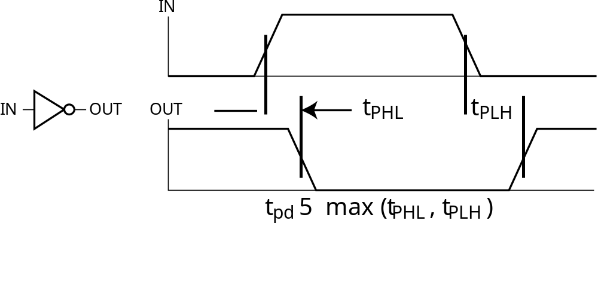
Propagation Delay (continued)
Propagation delays measured at the midpoint between the L and H values
What is the expression for the t_{PHL} delay for:
  a string of n identical buffers?
  a string of n identical inverters?
Chapter 3 - Part 1 <number>

Slide 13
Propagation Delay Example
Find t_{PHL}, t_{PLH} and t_{pd} for the signals given
IN (volts)
OUT (volts)
t (ns)
1.0 ns per division
Chapter 3 - Part 1 <number>
Notes:
t_{PHL} = 1.4 ns, t_{PLH} = 1.1 ns, t_{pd} = 1.25 ns

Slide 14
Delay Models
Transport delay - a change in the output in response to a change on the inputs occurs after a fixed specified delay
Inertial delay - similar to transport delay, except that if the input changes such that the output is to change twice in a time interval less than the rejection time, the output changes do not occur. Models typical electronic circuit behavior, namely, rejects narrow “pulses” on the outputs
Chapter 3 - Part 1 <number>

Slide 15
Delay Model Example
A
B
A B:
No Delay
(ND)
a
b
c
d
e
Transport
Delay (TD)
Inertial
Delay (ID)
0
2
4
6
8
10
12
14
16
Time (ns)
Propagation Delay = 2.0 ns Rejection Time = 1 .0 ns
Chapter 3 - Part 1 <number>

Slide 16
Fan-out
Fan-out can be defined in terms of a standard load
  Example: 1 standard load equals the load contributed by the input of 1 inverter.
  Transition time -the time required for the gate output to change from H to L, t_{HL}, or from L to H, t_{LH}
  The maximum fan-out that can be driven by a gate is the number of standard loads the gate can drive without exceeding its specified maximum transition time
Chapter 3 - Part 1 <number>

Slide 17
Fan-out and Delay
The fan-out loading a gate’s output affects the gate’s propagation delay
Example:
  One realistic equation for t_{pd} for a NAND gate with 4 inputs is:
    t_{pd} = 0.07 + 0.021 SL ns
  SL is the number of standard loads the gate is driving, i. e., its fan-out in standard loads
  For SL = 4.5, t_{pd} = 0.165 ns
Chapter 3 - Part 1 <number>

Slide 18
Cost
In an integrated circuit:
  The cost of a gate is proportional to the chip area occupied by the gate
  The gate area is roughly proportional to the number and size of the transistors and the amount of wiring connecting them
  Ignoring the wiring area, the gate area is roughly proportional to the gate input count
  So gate input count is a rough measure of gate cost
If the actual chip layout area occupied by the gate is known, it is a far more accurate measure
Chapter 3 - Part 1 <number>

Slide 19
Positive and Negative Logic
The same physical gate has different logical meanings depending on interpretation of the signal levels.
Positive Logic
  HIGH (more positive) signal levels represent Logic 1
  LOW (less positive) signal levels represent Logic 0
Negative Logic
  LOW (more negative) signal levels represent Logic 1
  HIGH (less negative) signal levels represent Logic 0
A gate that implements a Positive Logic AND function will implement a Negative Logic OR function, and vice-versa.
Chapter 3 - Part 1 <number>

Slide 20
Positive and Negative Logic (continued)
Given this signal level table:
What logic function is implemented?
Input
Output
X Y
L
L
L
L H
H
H L
H
H
H
H
Positive
(H = 1)
Negative
(H = 0)
Logic
(L = 0)
Logic
(L = 1)
0 0
0
1 1
1
0 1
1
1 0
0
1 0
1
0 1
0
1 1
1
0 0
0
Chapter 3 - Part 1 <number>
Notes:
Positive Logic: OR
Negative Logic: GO TO NEXT SLIDE

Slide 21
Positive and Negative Logic (continued)
Rearranging the negative logic terms to the standard function table order:
Positive
(H = 1)
Negative
(H = 0)
Logic
(L = 0)
Logic
(L = 1)
0 0
0
0 0
0
0 1
1
0 1
0
1 0
1
1 0
0
1 1
1
1 1
1
Chapter 3 - Part 1 <number>
Notes:
Negative Logic: AND

Slide 22
Logic Symbol Conventions
Use of polarity indicator to represent use of negative logic convention on gate inputs or outputs
X
Y
Z
X
CKT
Z
L
L
L
Y
L
H
H
Logic Circuit
H
L
H
H
H
H
X
X
Z
Z
Y
Y
Positive Logic
Negative Logic
Chapter 3 - Part 1 <number>

Slide 23
Design Trade-Offs
Cost - performance tradeoffs
Gate-Level Example:
  NAND gate G with 20 standard loads on its output has a delay of 0.45 ns and has a normalized cost of 2.0
  A buffer H has a normalized cost of 1.5. The NAND gate driving the buffer with 20 standard loads gives a total delay of 0.33 ns
  In which if the following cases should the buffer be added?
    The cost of this portion of the circuit cannot be more than 2.5
    The delay of this portion of the circuit cannot be more than 0.40 ns
    The delay of this portion of the circuit must be less than 0.30 ns and the cost less than 3.0
Tradeoffs can also be accomplished much higher in the design hierarchy
Constraints on cost and performance have a major role in making tradeoffs
Chapter 3 - Part 1 <number>
Notes:
1. No buffer
2. Use buffer
3. Irrelevant - buffer needed to satisfy delay constraint, but cannot satisfy cost constraint.

Slide 24
Design Procedure
Specification
  Write a specification for the circuit if one is not already available
Formulation
  Derive a truth table or initial Boolean equations that define the required relationships between the inputs and outputs, if not in the specification
Optimization
  Apply 2-level and multiple-level optimization
  Draw a logic diagram or provide a netlist for the resulting circuit using ANDs, ORs, and inverters
Chapter 3 - Part 1 <number>

Slide 25
Design Procedure
Technology Mapping
  Map the logic diagram or netlist to the implementation technology selected
Verification
  Verify the correctness of the final design
Chapter 3 - Part 1 <number>

Slide 26
Design Example
Specification
  BCD to Excess-3 code converter
  Transforms BCD code for the decimal digits to Excess-3 code for the decimal digits
  BCD code words for digits 0 through 9: 4-bit patterns 0000 to 1001, respectively
  Excess-3 code words for digits 0 through 9: 4-bit patterns consisting of 3 (binary 0011) added to each BCD code word
  Implementation:
    multiple-level circuit
    NAND gates (including inverters)
Chapter 3 - Part 1 <number>

Slide 27
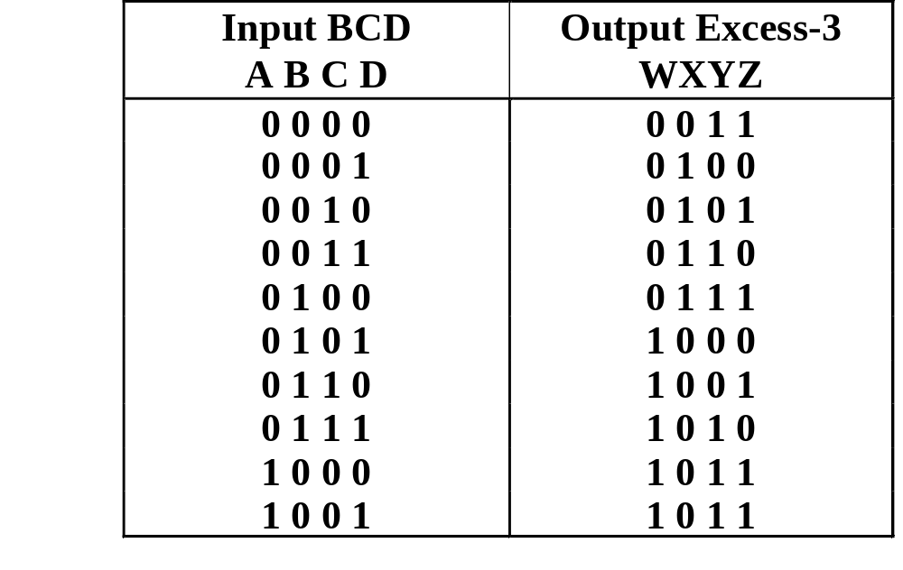
Design Example (continued)
Formulation
  Conversion of 4-bit codes can be most easily formulated by a truth table
  Variables
  - BCD:
  A,B,C,D
  Variables
  - Excess-3
  W,X,Y,Z
  Don’t Cares
  - BCD 1010
  to 1111
Chapter 3 - Part 1 <number>

Slide 28
Design Example (continued)
C
C
Optimization
  2-level using
  K-maps
W = A + BC + BD
X = C + D + B
Y = CD +
Z =
z
y
1
1
1
1
0
1
3
2
0
1
3
2
1
1
1
1
4
5
7
6
B
4
5
7
6
B
X
X
X
X
X
X
X
X
A
12
13
15
14
A
12
13
15
14
1
X
X
1
X
X
B
B
C
D
8
9
11
10
8
9
11
10
D
D
C
D
D
x
C
C
w
1
1
1
0
1
3
2
0
1
3
2
1
1
1
1
4
5
7
6
B
4
5
7
6
B
X
X
X
X
X
X
X
X
A
12
13
15
14
A
12
13
15
14
1
X
X
1
1
X
X
8
9
11
10
8
9
11
10
D
D
Chapter 3 - Part 1 <number>

Slide 29
Design Example (continued)
Optimization (continued)
  Multiple-level using transformations
  W = A + BC + BD
  X = C + D + B
  Y = CD +
  Z = G = 7 + 10 + 6 + 0 = 23
  Perform extraction, finding factor:
  T₁ = C + D
  W = A + BT₁
  X = T₁ + B
  Y = CD +
  Z = G = 2 + 1 + 4 + 7 + 6 + 0 = 19
B
B
C
D
C
D
D
B
C
D
C
D
D
Chapter 3 - Part 1 <number>

Slide 30
Design Example (continued)
Optimization (continued)
  Multiple-level using transformations
  T₁ = C + D
  W = A + BT₁
  X = T₁ + B
  Y = CD +
  Z = G = 19
  An additional extraction not shown in the text since it uses a Boolean transformation: ( = C + D = ):
  W = A + BT₁
  X = T₁ + B
  Y = CD +
  Z = G = 2 +1 + 4 + 6 + 4 + 0 = 16!
B
C
D
C
D
D
C
D
T₁
B
T₁
T₁
D
Chapter 3 - Part 1 <number>

Slide 31
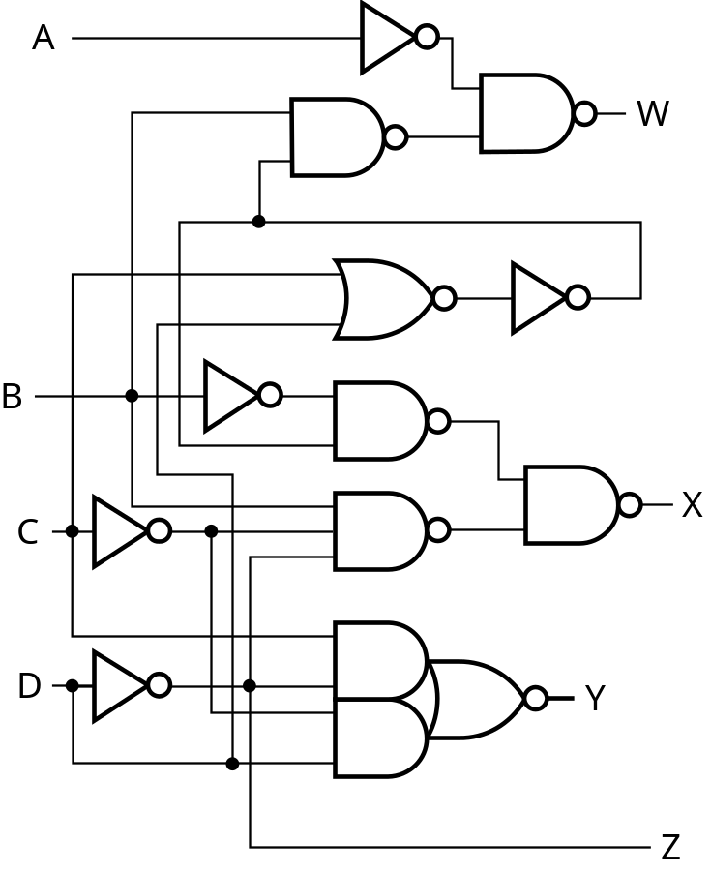
Design Example (continued)
Technology Mapping
  Mapping with a library containing inverters and 2-input NAND, 2-input NOR, and 2-2 AOI gates
A
W
B
X
C
Y
D
Z
Chapter 3 - Part 1 <number>

Slide 32
Technology Mapping
Chip design styles
Cells and cell libraries
Mapping Techniques
  NAND gates
  NOR gates
  Multiple gate types
  Programmable logic devices
    The subject of Chapter 3 - Part 2
Chapter 3 - Part 1 <number>

Slide 33
Chip Design Styles
Full custom - the entire design of the chip down to the smallest detail of the layout is performed
  Expensive
  Justifiable only for dense, fast chips with high sales volume
Standard cell - blocks have been design ahead of time or as part of previous designs
  Intermediate cost
  Less density and speed compared to full custom
Gate array - regular patterns of gate transistors that can be used in many designs built into chip - only the interconnections between gates are specific to a design
  Lowest cost
  Less density compared to full custom and standard cell
Chapter 3 - Part 1 <number>

Slide 34
Cell Libraries
Cell - a pre-designed primitive block
Cell library - a collection of cells available for design using a particular implemen-tation technology
Cell characterization - a detailed specification of a cell for use by a designer - often based on actual cell design and fabrication and measured values
Cells are used for gate array, standard cell, and in some cases, full custom chip design
Chapter 3 - Part 1 <number>

Slide 35
Typical Cell Characterization Components
Schematic or logic diagram
Area of cell
  Often normalized to the area of a common, small cell such as an inverter
Input loading (in standard loads) presented to outputs driving each of the inputs
Delays from each input to each output
One or more cell templates for technology mapping
One or more hardware description language models
If automatic layout is to be used:
  Physical layout of the cell circuit
  A floorplan layout providing the location of inputs, outputs, power and ground connections on the cell
Chapter 3 - Part 1 <number>

Slide 36
Example Cell Library
Typical
Typical
Input-to-
Basic
Cell
Cell
Normalized
Input
Output
Function
Name
Schematic
Area
Load
Delay
Templates
Inverter
1.00
1.00
0.04
1
0.012
3
SL
2NAND
1.25
1.00
0.05
1
0.014
3
SL
2NOR
1.25
1.00
0.06
1
0.018
3
SL
2-2 AOI
2.25
0.95
0.07
1
0.019
3
SL
Chapter 3 - Part 1 <number>

Slide 37
Mapping to NAND gates
Assumptions:
  Gate loading and delay are ignored
  Cell library contains an inverter and n-input NAND gates, n = 2, 3, …
  An AND, OR, inverter schematic for the circuit is available
The mapping is accomplished by:
  Replacing AND and OR symbols,
  Pushing inverters through circuit fan-out points, and
  Canceling inverter pairs
Chapter 3 - Part 1 <number>

Slide 38
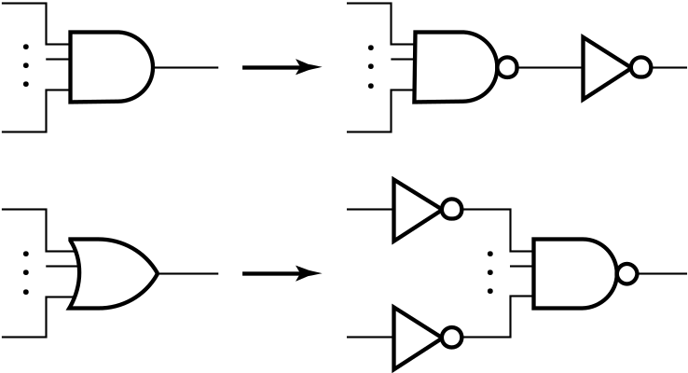
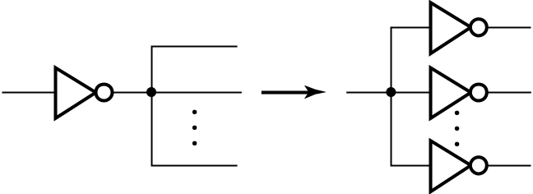

NAND Mapping Algorithm
Replace ANDs and ORs:
Repeat the following pair of actions until there is at most one inverter between :
  A circuit input or driving NAND gate output, and
  The attached NAND gate inputs.
Chapter 3 - Part 1 <number>

Slide 39
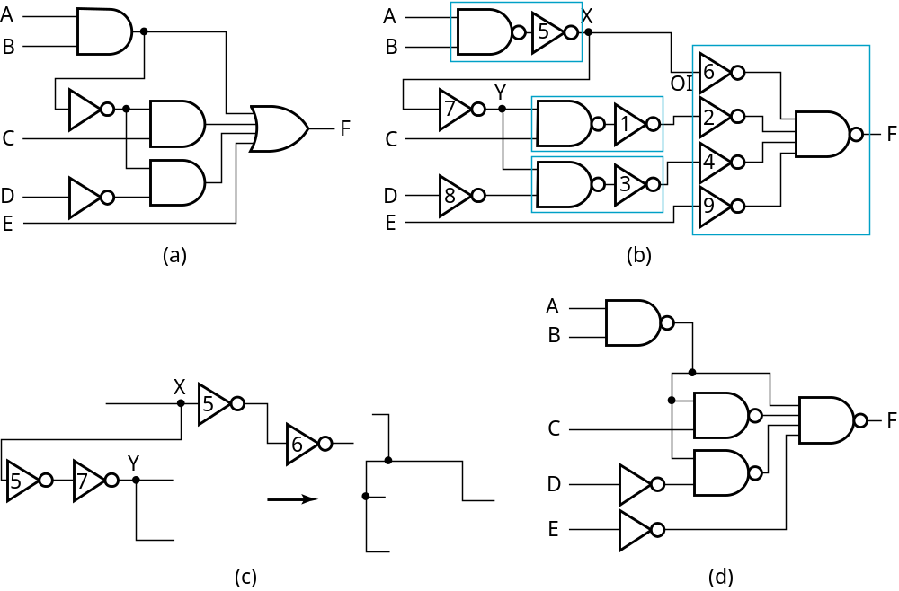
NAND Mapping Example
Chapter 3 - Part 1 <number>

Slide 40
Mapping to NOR gates
Assumptions:
  Gate loading and delay are ignored
  Cell library contains an inverter and n-input NOR gates, n = 2, 3, …
  An AND, OR, inverter schematic for the circuit is available
The mapping is accomplished by:
  Replacing AND and OR symbols,
  Pushing inverters through circuit fan-out points, and
  Canceling inverter pairs
Chapter 3 - Part 1 <number>

Slide 41
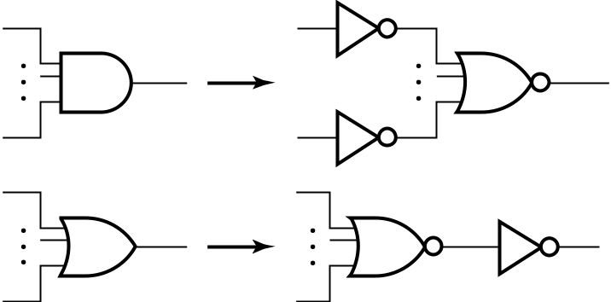
NOR Mapping Algorithm
Replace ANDs and ORs:
Repeat the following pair of actions until there is at most one inverter between :
  A circuit input or driving NAND gate output, and
  The attached NAND gate inputs.
Chapter 3 - Part 1 <number>

Slide 42
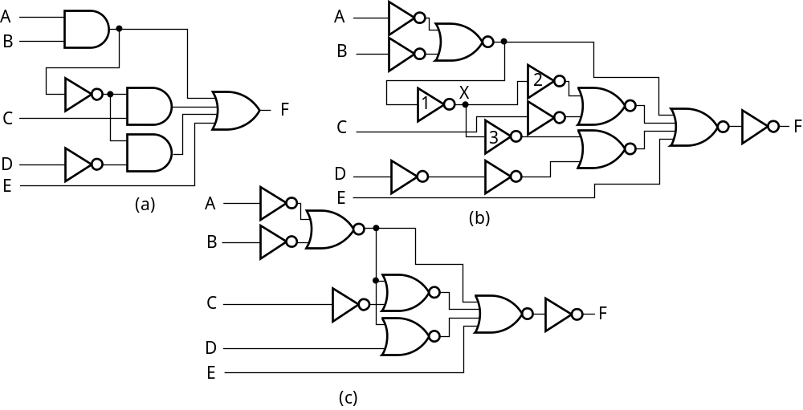
NOR Mapping Example
Chapter 3 - Part 1 <number>

Slide 43
Mapping Multiple Gate Types
Algorithm is available in the Advanced Technology Mapping reading supplement
Cell library contains gates of more than one “type”
Concept Set 1
  Steps
    Replace all AND and OR gates with optimum equivalent circuits consisting only of 2-input NAND gates and inverters.
    Place two inverters in series in each line in the circuit containing NO inverters
  Justification
    Breaks up the circuit into small standardize pieces to permit maximum flexibility in the mapping process
    For the equivalent circuits, could use any simple gate set that can implement AND, OR and NOT and all of the cells in the cell library
Chapter 3 - Part 1 <number>

Slide 44
Mapping Multiple Gate Types
Concept Set 2
  Fan-out free subcircuit - a circuit in which a single output cell drives only one other cell
  Steps
    Use an algorithm that guarantees an optimum solution for “fan-out free” subcircuits by replacing interconnected inverters and 2-input NAND gates with cells from the library
    Perform inverter “canceling” and “pushing” as for the NAND and NOR
  Justification
    Steps given optimize the total cost of the cells used within “fan-out free” subcircuits of the circuit
End result: An optimum mapping solution within the “fan-out free subcircuits”
Chapter 3 - Part 1 <number>

Slide 45
Example: Mapping Multiple Cell Types
Uses same example circuit as NAND mapping and NOR mapping
Cell library: 2-input and 3-input NAND gates, 2-input NOR gate, and inverter
Circuits on next slide
(a) Optimized multiple-level circuit
(b) Circuit with AND and OR gates replaced with circuits of 2-input NAND gates and inverters (Outlines show 2-input NANDs and inverter sets mapped to library cells in next step)
(c) Mapped circuit with inverter pairs cancelled
(d) Circuit with remaining inverters minimized
Chapter 3 - Part 1 <number>

Slide 46
Example: Mapping Multiple Gate Types
A
A
B
B
C
F
C
F
D
D
E
E
(a)
(b)
A
B
A
B
C
F
C
F
D
D
E
E
(c)
(d)
Chapter 3 - Part 1 <number>

Slide 47
Verification
Verification - show that the final circuit designed implements the original specification
Simple specifications are:
  truth tables
  Boolean equations
  HDL code
If the above result from formulation and are not the original specification, it is critical that the formulation process be flawless for the verification to be valid!
Chapter 3 - Part 1 <number>

Slide 48
Basic Verification Methods
Manual Logic Analysis
  Find the truth table or Boolean equations for the final circuit
  Compare the final circuit truth table with the specified truth table, or
  Show that the Boolean equations for the final circuit are equal to the specified Boolean equations
Simulation
  Simulate the final circuit (or its netlist, possibly written as an HDL) and the specified truth table, equations, or HDL description using test input values that fully validate correctness.
  The obvious test for a combinational circuit is application of all possible “care” input combinations from the specification
Chapter 3 - Part 1 <number>

Slide 49
Verification Example: Manual Analysis
BCD-to-Excess 3 Code Converter
  Find the SOP Boolean equations from the final circuit.
  Find the truth table from these equations
  Compare to the formulation truth table
Finding the Boolean Equations:
T₁ = C + D = C + D
W = A (T₁ B) = A + B T₁
X = (T₁ B) (B ) = T₁ + B
Y = C + D = CD +
C
D
B
C
D
D
C
C
D
Chapter 3 - Part 1 <number>

Slide 50
Verification Example: Manual Analysis
Find the circuit truth table from the equations and compare to specification truth table:
Input BCD
Output Excess
-
3
Input BCD
Output Excess
-
3
A B C D
WXYZ
A B C D
WXYZ
0 0 0 0
0 0 1 1
0 0 0 0
0 0 1 1
0 0 0 1
0 1 0 0
0 0 0 1
0 1 0 0
0 0 1 0
0 1 0 1
0 0 1 0
0 1 0 1
0 0 1 1
0 1 1 0
0 0 1 1
0 1 1 0
0 1 0 0
0 1 1 1
0 1 0 0
0 1 1 1
0 1 0 1
1 0 0 0
0 1 0 1
1 0 0 0
0 1 1 0
1 0 0 1
0 1 1 0
1 0 0 1
0 1 1 1
1 0 1 0
0 1 1 1
1 0 1 0
1 0 0 0
1 0 1 1
1 0 0 0
1 0 1 1
1 0 0 1
1 0 1 1
1 0 0 1
1 0 1 1
The tables match!
Chapter 3 - Part 1 <number>
Notes:
Since the outputs are not specified for the don’t cares, no analysis for correctness is needed.

Slide 51
Verification Example: Simulation
Simulation procedure:
  Use a schematic editor or text editor to enter a gate level representation of the final circuit
  Use a waveform editor or text editor to enter a test consisting of a sequence of input combinations to be applied to the circuit
    This test should guarantee the correctness of the circuit if the simulated responses to it are correct
    Short of applying all possible “care” input combinations, generation of such a test can be difficult
Chapter 3 - Part 1 <number>

Slide 52
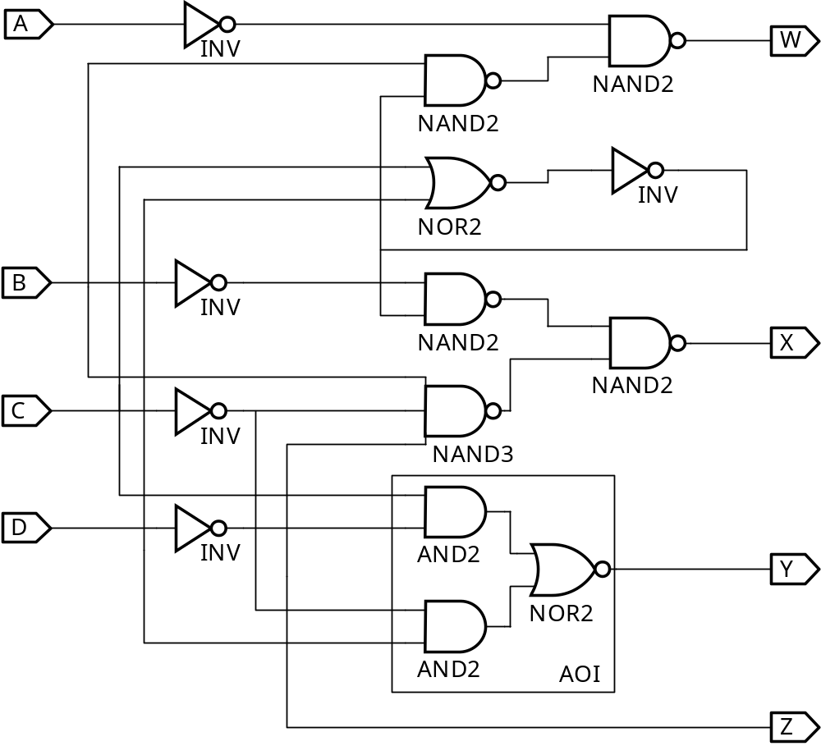
Verification Example: Simulation
Enter BCD-to-Excess-3 Code Converter Circuit Schematic
AOI symbol
not available
Chapter 3 - Part 1 <number>

Slide 53
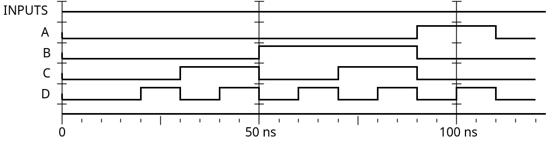
Verification Example: Simulation
Enter waveform that applies all possible input combinations:
Are all BCD input combinations present? (Low is a 0 and high is a one)
Chapter 3 - Part 1 <number>
Notes:
Yes, 0000 through 1001 are present.

Slide 54
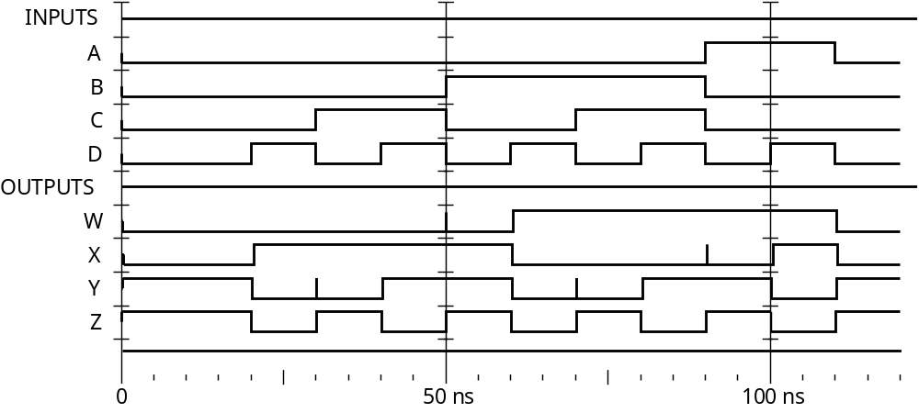
Verification Example: Simulation
Run the simulation of the circuit for 120 ns
Do the simulation output combinations match the original truth table?
Chapter 3 - Part 1 <number>
Notes:
Yes, the output combinations 0011 through 1100 occur in response to 0000 through 1001, respectively.

Slide 55
Terms of Use
© 2004 by Pearson Education,Inc. All rights reserved.
The following terms of use apply in addition to the standard Pearson Education Legal Notice.
Permission is given to incorporate these materials into classroom presentations and handouts only to instructors adopting Logic and Computer Design Fundamentals as the course text.
Permission is granted to the instructors adopting the book to post these materials on a protected website or protected ftp site in original or modified form. All other website or ftp postings, including those offering the materials for a fee, are prohibited.
You may not remove or in any way alter this Terms of Use notice or any trademark, copyright, or other proprietary notice, including the copyright watermark on each slide.
Return to Title Page
Chapter 3 - Part 1 <number>

